Slide 1
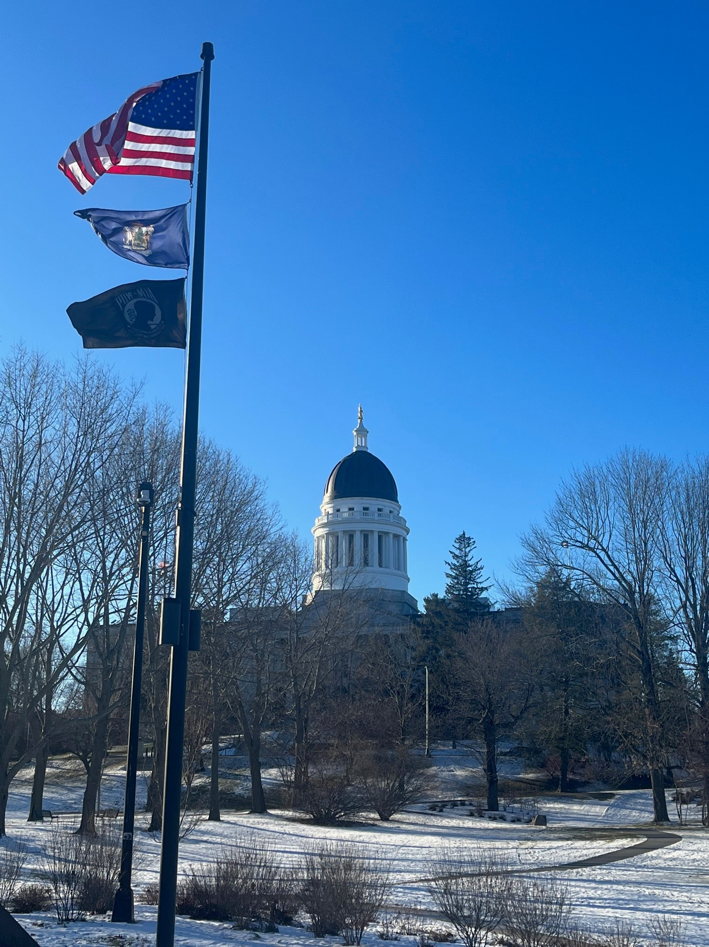
Maine State Legislature
Tax Expenditure Review Process
Briefing by the Legislature’s
Office of Program Evaluation and Government Accountability
January 2023

Slide 2
Enactment & National Context
PL2015 chapter 344 established Maine’s current tax expenditure review process. (See 3 MRSA §§ 998-1001).
Maine is now one of more than 30 states that regularly review their tax expenditure programs.
PEW Charitable Trust has highlighted Maine as a leader in tax incentive evaluation.

Slide 3
The Maine Legislature LEADS L

Slide 4
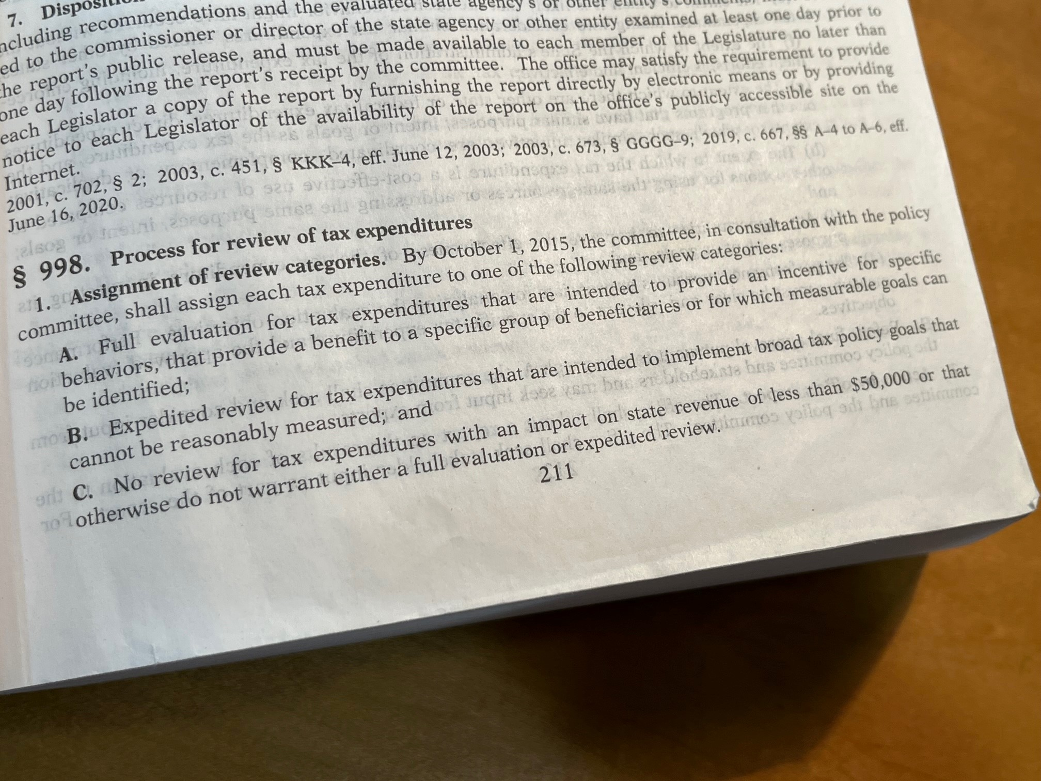
Title 3 Ch. 37 Governs Maine’s Process
The Government Oversight Committee is charged with identifying the universe of tax expenditures in Maine and determining the level of review each should receive.
The 3 categories of review include:
Full Evaluation;
Expedited Review; and
No Review.
The GOC makes these determinations in consultation with the Taxation Committee.

Slide 5
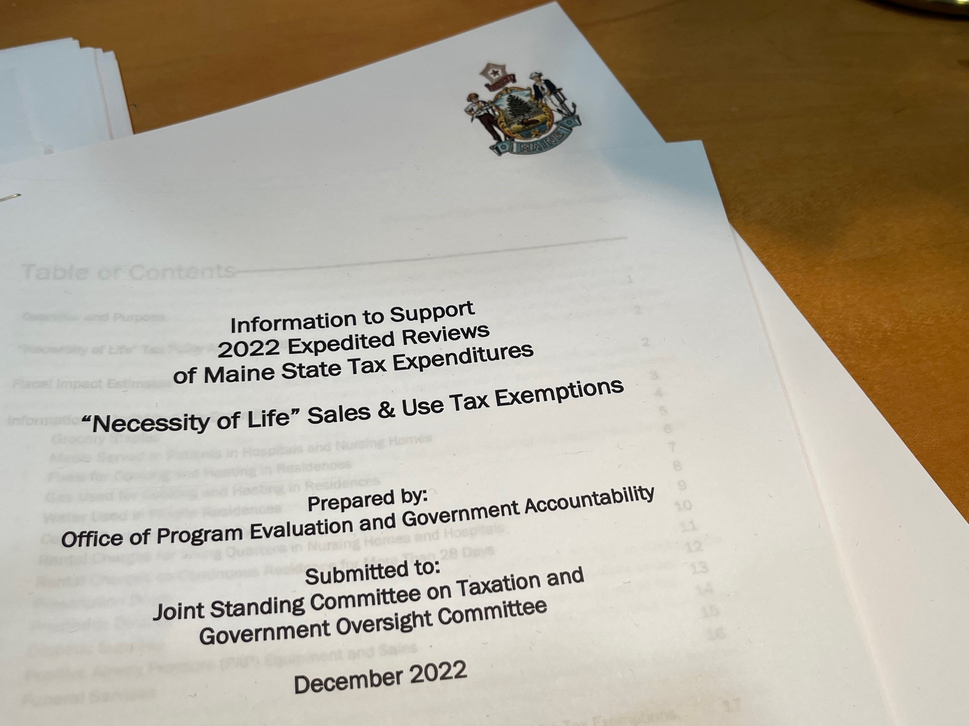
Expedited Review of Tax Expenditures - 3 MRSA §1000
The Taxation Committee conducts these reviews annually to assess the continued relevance of, or need for adjustments to, both:
the broader tax policy area under review, and
the individual expenditures grouped in that policy area.
OPEGA provides a summary of information to support the Taxation Committee’s review, as required by 3 MRSA §1000(2).
https://legislature.maine.gov/doc/9299
The Taxation Committee reports its results to the Legislature and is authorized to submit implementing legislation.

Slide 6
Expedited Reviews Completed by Taxation Committee
The expenditures designated for expedited review were divided into policy area clusters across a 6-year cycle.
The full 6-year cycle has come before the Taxation Committee for review, and we are now in the second 6-year cycle.

Slide 7
Full Evaluation of Tax Expenditures - 3 MRSA §999
Full evaluations are conducted by OPEGA in accordance with statute and the tax expenditure review schedule set by the Government Oversight Committee.
The parameters are set for each full evaluation by the Government Oversight Committee, in consultation with the Taxation Committee, after receipt of stakeholder input.
Results are reported to both the Government Oversight Committee and the Taxation Committee.

Slide 8
Full Evaluations Completed by OPEGA
New Markets Capital Investment Credit
Pine Tree Development Zones (PTDZ)
Employment Tax Increment Financing (ETIF)
Business Equipment Tax Reimbursement (BETR) & Business Equipment Tax Exemption (BETE)
Maine Capital Investment Credit (MCIC)
Seed Capital Investment Credit
Credit for Rehabilitation of Historic Properties
Research Expense Tax Credit

Slide 9
In Process & Upcoming
In Process Now
Visual Media Incentives
Deduction for Contributions to Capital Construction Funds for Fishing Vessels
On the Horizon
Shipbuilding Facility Credit
Major Business Headquarters Expansion Credit
Major Food Processing & Manufacturing Facilities Expansion Credit
Paper Manufacturing Facility Investment Credit

Slide 10
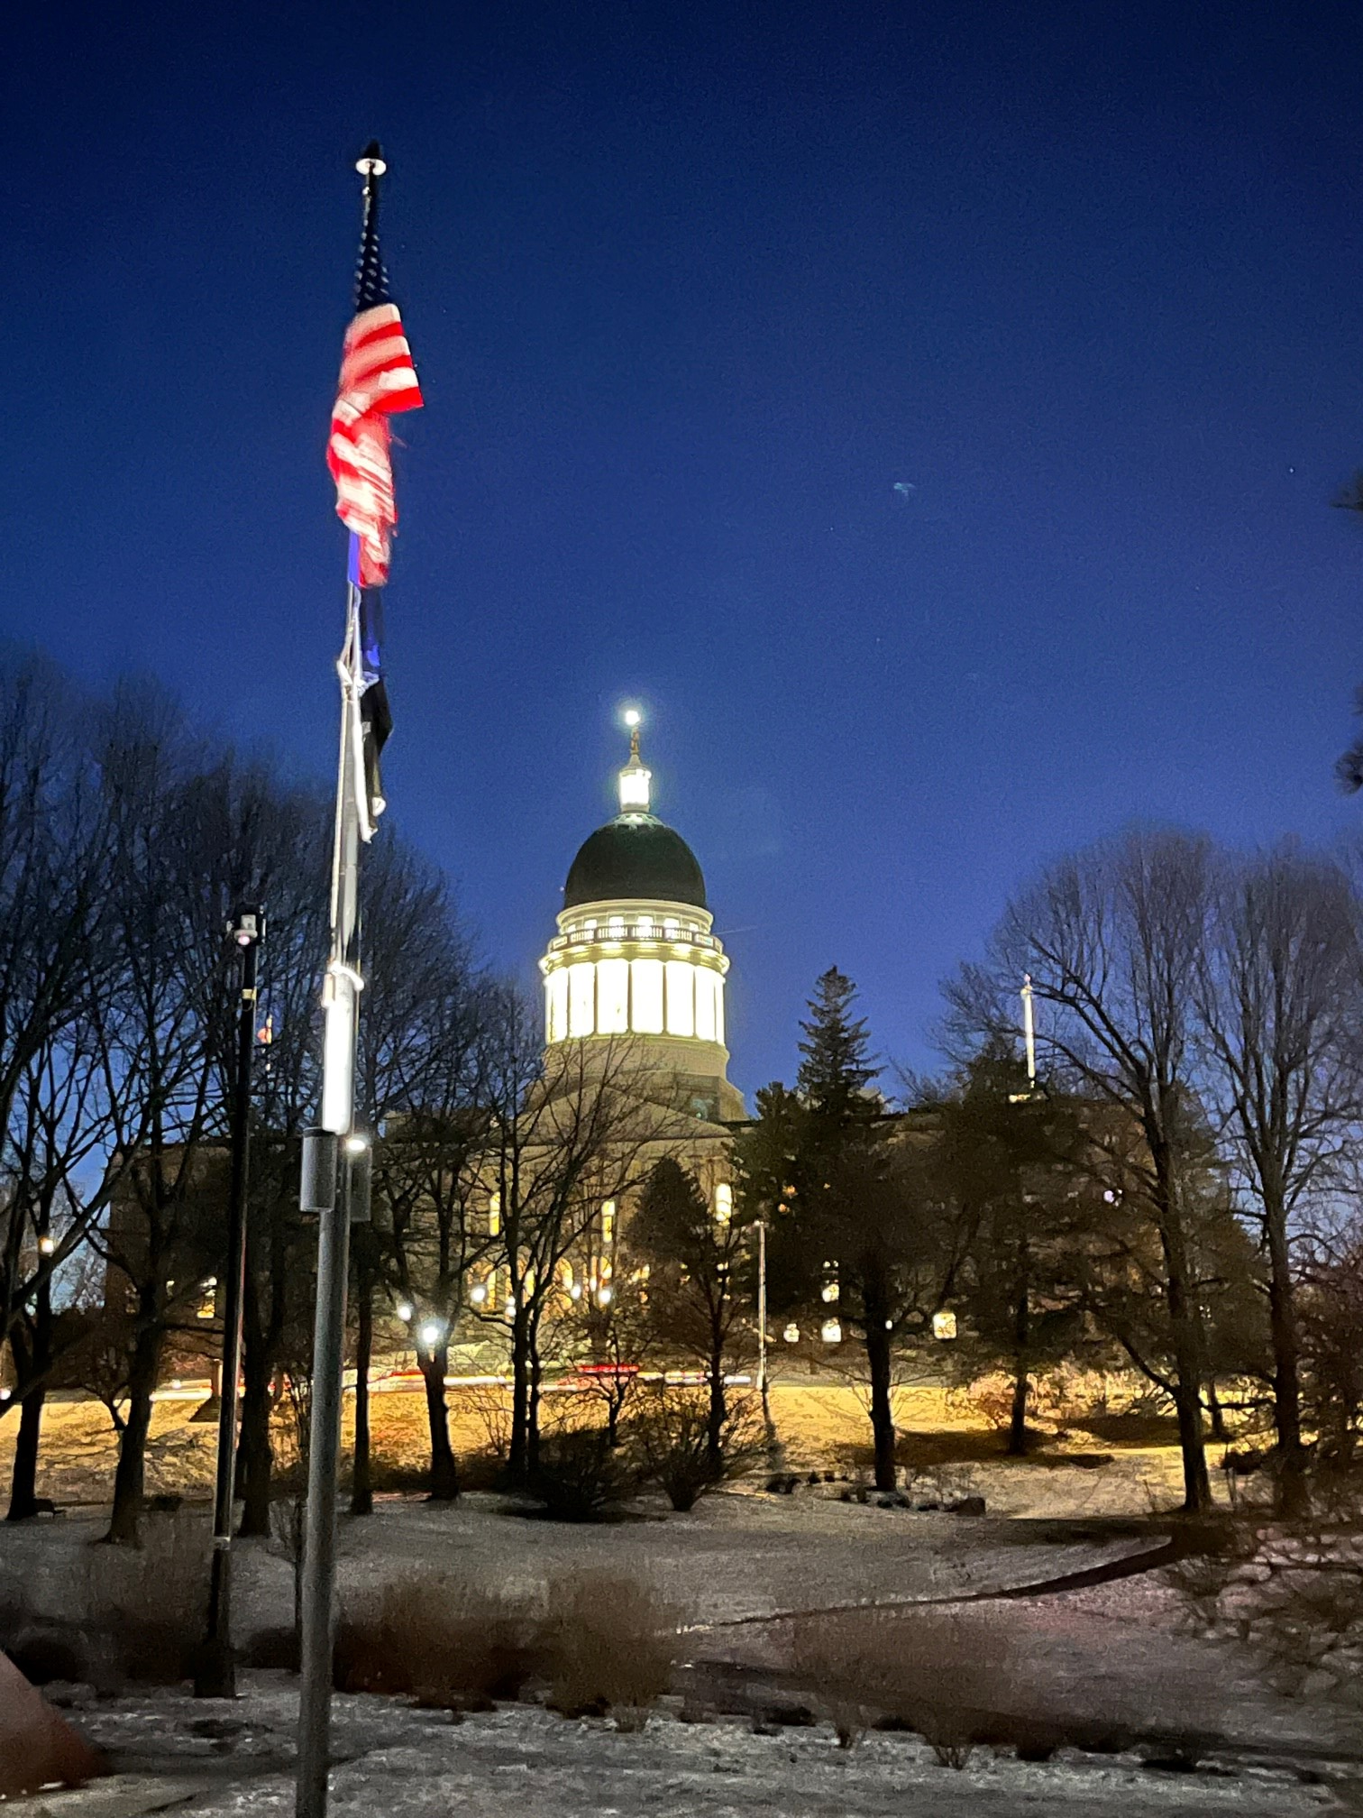
Thank You
We Welcome Your Questions
OPEGA
82 State House Station Room 104, Cross State Office Building Augusta, ME 04333-0082
(207) 287-1901
http://legislature.maine.gov/opega/

